Slide 1
Amazon Sales Data analysis Capstone Project Presentation
By
RAISHABANU

Slide 2
OBJECTIVE
"Amazon is a leading e-commerce platform with vast amounts of data. This project aims to analyze Amazon sales data to uncover trends and insights that can help optimize product_line, understand customer preferences, and improve sales strategies in different branches of different city"

Slide 3
Software Specifications: Workstation OS: Windows 10 Database Management: Database: MySQL 8.0 Hardware Specifications: Processor: Intel i5 RAM: 8GB DDR4 Storage: 512 SSD

Slide 4
Project Goals
The goals of this project are to:
Identify best selling product_line and product_line need to be improved.
Analyze customer_segment on purchase and ratings.
Track sales trends over time.
Provide actionable recommendations for inventory management.

Slide 5
Data and Description
This dataset contains sales transactions from three different branches of Amazon, respectively located in Mandalay, Yangon and Naypyitaw. The data contains 17 columns and 1000 rows
Column | Description | Data Type
invoice_id | Invoice of the sales made | VARCHAR(30)
branch | Branch at which sales were made | VARCHAR(5)
city | The location of the branch | VARCHAR(30)
customer_type | The type of the customer | VARCHAR(30)
gender | Gender of the customer making purchase | VARCHAR(10)
product_line | Product line of the product sold | VARCHAR(100)
unit_price | The price of each product | DECIMAL(10, 2)
quantity | The amount of the product sold | INT
VAT | The amount of tax on the purchase | FLOAT(6, 4)
total | The total cost of the purchase | DECIMAL(10, 2)
date | The date on which the purchase was made | DATE
time | The time at which the purchase was made | TIMESTAMP
payment_method | The total amount paid | DECIMAL(10, 2)
cogs | Cost Of Goods sold | DECIMAL(10, 2)
gross_margin_percentage | Gross margin percentage | FLOAT(11, 9)
gross_income | Gross Income | DECIMAL(10, 2)
rating | Rating | FLOAT(2, 1)

Slide 6
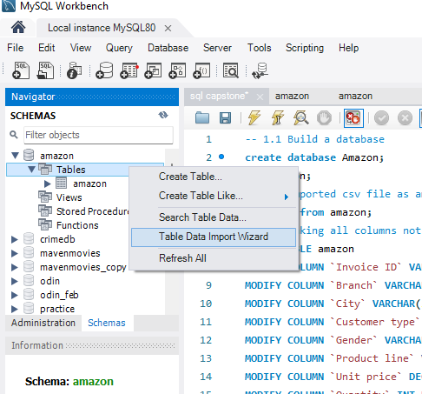
Data Ingestion and Cleaning
Data is in csv format and ingested using table data import wizard and there is no null values in the data provided

Slide 7
Feature Creation
3 new columns were added to enhance the analysis process
1.time_of_day → Morning,Afternoon,Evening
2.day_name → Sunday,Monday,Tuesday,Wednesday,Thursday,Friday,Saturday
3.month_name → Jan,Feb,Mar,Apr,May,Jun,Jul,Aug,Sep,Oct,Nov,Dec.

Slide 8
Product Analysis-Insights
Distinct Product_line | Sales Label- (>Avg_sales) | REVENUE | TAX | GENDER | AVG_ RATING
Food and beverages | GOOD | Highest-56144.96 | Highest-2673.56 |  | 7.11
Sports and travel | BAD |  |  | Male | 6.92
Electronic accessories | GOOD |  |  |  | 6.92
Fashion accessories | GOOD Highest sale |  |  |  | 7.03
Home and lifestyle | BAD |  |  |  | 6.84
Health and beauty | BAD | Lowest-49193.84 | Lowest-2342.55 | Female | 7.00

Slide 9
Product_line-Recommendation
1.We need to increase sports and travel product category for female and give some offers for women centric products.
2. Male beauty products should be brought homepage, More online ads regarding detan, beardo, haircare of male can be created
3. Home and Lifestyle:
Limited-Time Offers: Create urgency with time-limited discounts or flash sales.
Bundling Products: Offer discounts on product bundles, encouraging customers to buy more.
4.Rating
Improve Customer Service
Live Chat: Offer live chat support to assist customers in real-time.
Easy Returns: Implement a hassle-free return policy to build trust and encourage purchases.

Slide 10
BRANCH AND CITY-INSIGHTS
BRANCH | CITY | HIGHEST_REVENUE | HI_VAT | >AVG_QUAN | GENDER
A | Yangon |  |  | 1859 | M-179
 |  |  |  |  | F-161
B | Mandalay |  |  |  | M-170
 |  |  |  |  | F-162
C | Naypyitaw | 110568.86 | 49.9% |  | M-150
 |  |  |  |  | F-178

Slide 11
Customer Type -Insights
Customer type | REVENUE | HIGH_VAT | Purchase-Freq | Gender
Member | 164223.81 | Member | Member-501 | Male-240
 |  |  |  | Female-261
Normal | 158743.62 |  |  | Male-259
 |  |  |  | Female-240

Slide 12
Recommendations
We should make normal people that too male to become member of amazon by providing offers like
free shipping,
one month free subscription,
2% super coins on every purchase,
free membership for person buying above certain threshold in previous year.

Slide 13
Time-Series Analysis Month-Wise
MONTH | REVENUE | COST OF GOOD(COG)
JAN | 116292.11 | 110754.16
FEB | 97219.58 | 92589.88
MAR | 109455.74 | 104243.34

Slide 14
Week-wise Analysis
DAY_NAME | TIME_OF_DAY | SALE_COUNT
Monday | Morning | 21
Monday | Afternoon | 75
Monday | Evening | 29
Tuesday | Morning | 36
Tuesday | Afternoon | 71
Tuesday | Evening | 51
Wednesday | Morning | 22
Wednesday | Afternoon | 81
Wednesday | Evening | 40
Thursday | Morning | 33
Thursday | Afternoon | 76
Thursday | Evening | 29
Friday | Morning | 29
Friday | Afternoon | 74
Friday | Evening | 36

Slide 15
DAY | Sales_count
Monday | 125
Tuesday | 158
Wednesday | 143
Thursday | 138
Friday | 139
Saturday | 164
Sunday | 133

Slide 16
Rating time for branch
BRANCH | High_AVG_RATING | Max_rating(10)
A | 7.31 (FRIDAY) | AFTERNOON
B | 7.33 (MONDAY) | (M.A,E)
C | 7.27 (FRIDAY) | AFTERNOON

Slide 17
RECOMMENDATIONS
Flash sale ,offers , coins for Rating on purchase can be provided on morning and evening time to increase the sale during that time

Slide 18
Conclusion
"This project provided valuable insights into Amazon sales data, helping to optimize inventory and sales strategies. Future work could involve expanding the dataset to include more variables.

Slide 19
Questions??????
Thank you for your attention. I'm happy to answer any questions you may have about the project.

